Slide 1
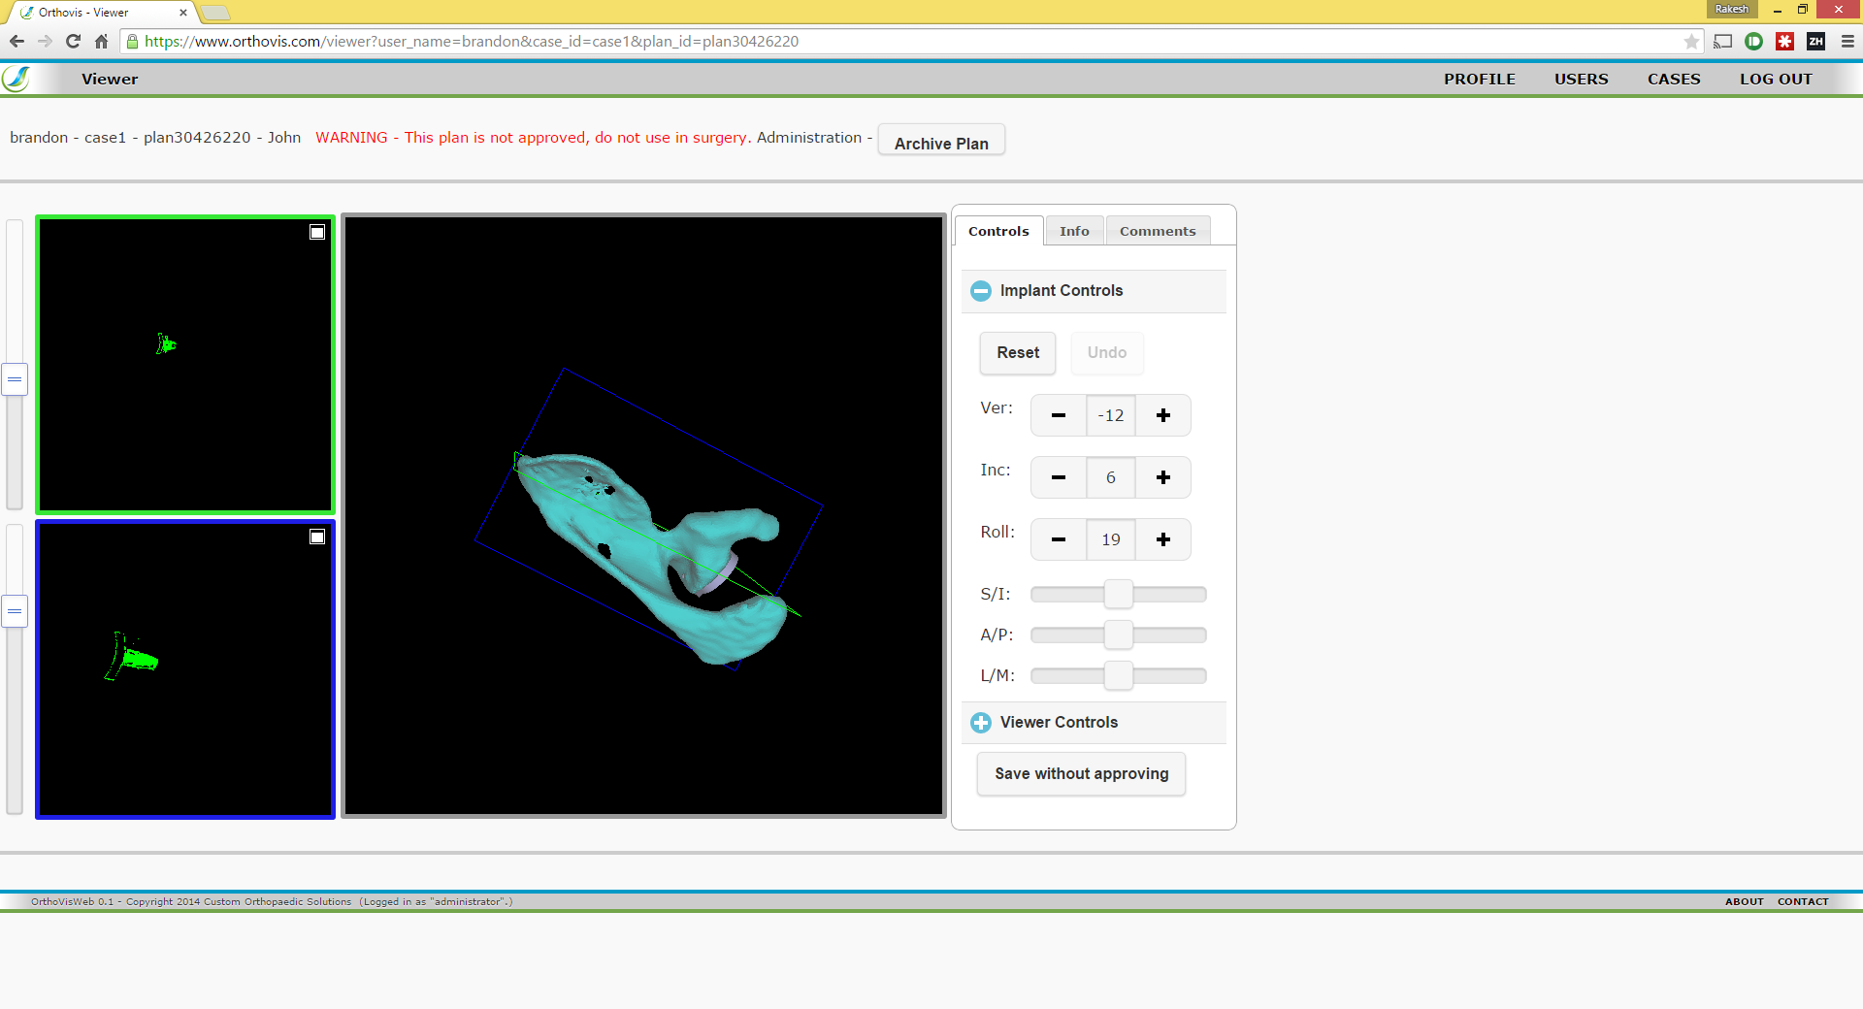

Slide 2
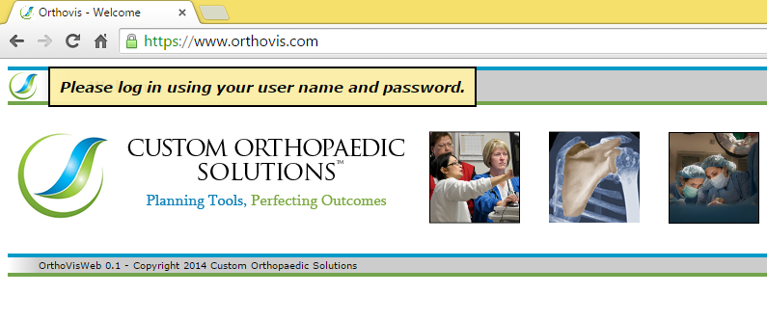
ALERT DIALOG

Slide 3
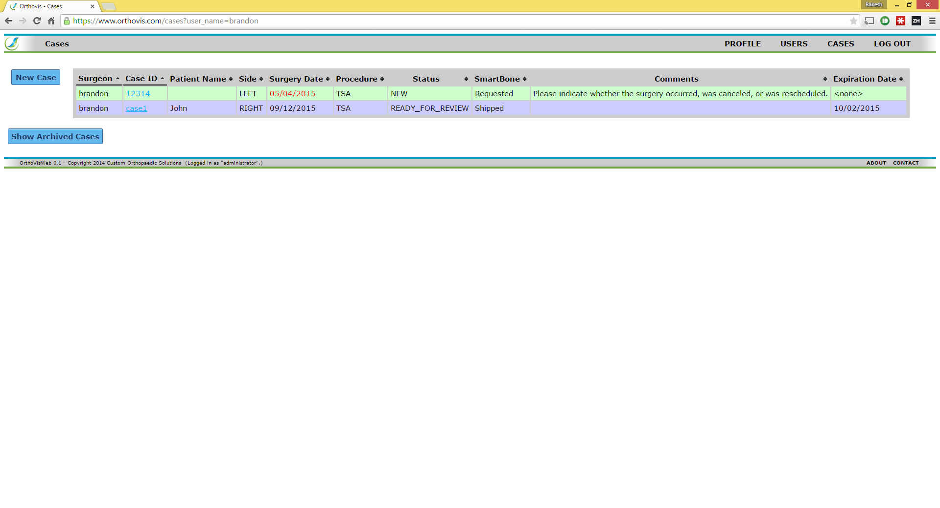

Slide 4
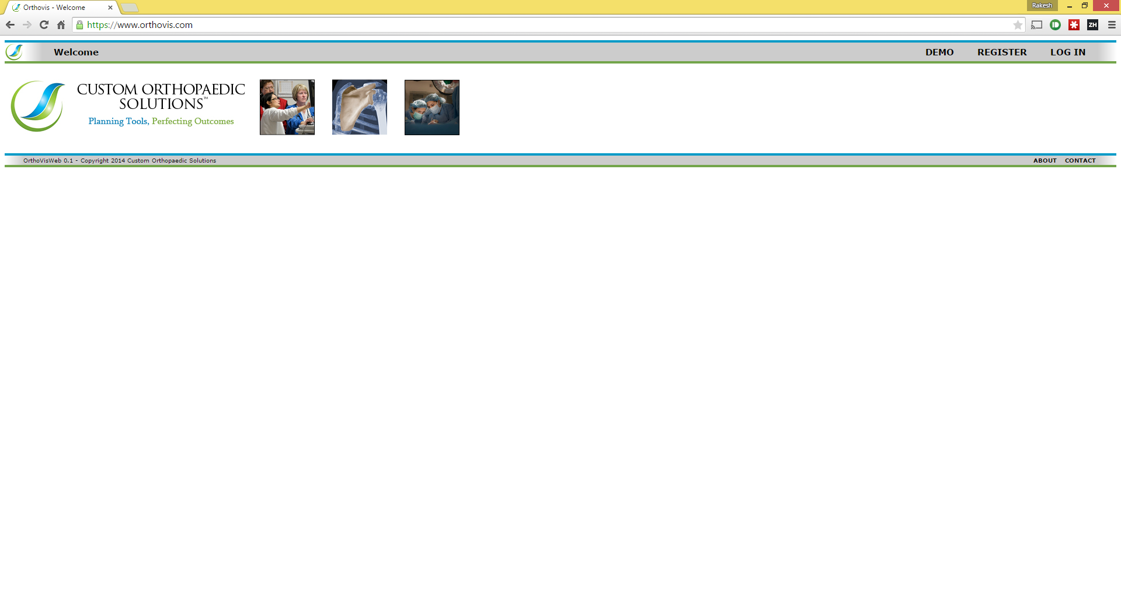

Slide 5
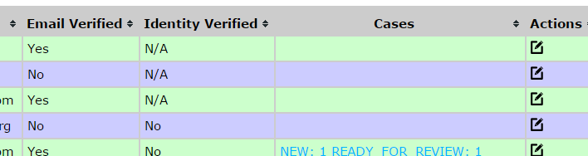
TABLES

Slide 7
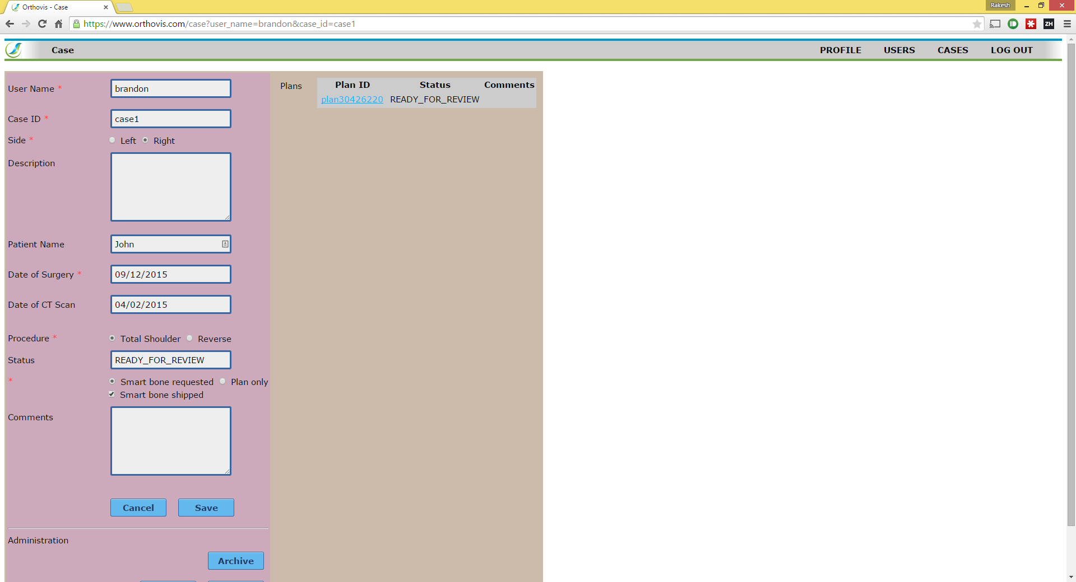

Slide 8
TEXT FIELDS
RADIO BUTTONS
CHECKBOXES
PRIMARY BUTTONS

Slide 9
ACCORDIAN
SPINNERS
SLIDERS

